Slide 1
Jermyn Borough Council Meeting
10/27/22

Slide 2
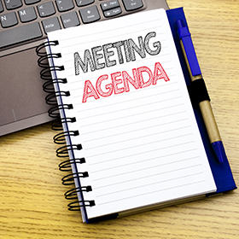
Meeting Agenda
October 27, 2022
CALL TO ORDER
PLEDGE OF ALLEGIANCE
ROLL CALL
PREVIOUS MEETING MINUTES
TREASURER REPORT/BILLS PAYABLE
CORRESPONDENCE
PUBLIC COMMENT
GARBAGE REMOVAL BID OPEINGS
PROFESSIONAL REPORTS
POLICE
FIRE
EMA
SOLICITOR
CODE ENFORCEMENT
ZONING
ENGINEER
TAX COLLECTOR
MAYOR
COMMITTEE REPORTS
CHICKEN ORDINANCE
LETEER TO MAYOR CHELIK
AMERICAN RESCUE FUND DOLLARS
MELLOW COURT
REGIONAL POLICE
COMCAST UPDATE
NEW BUSINESS

Slide 3
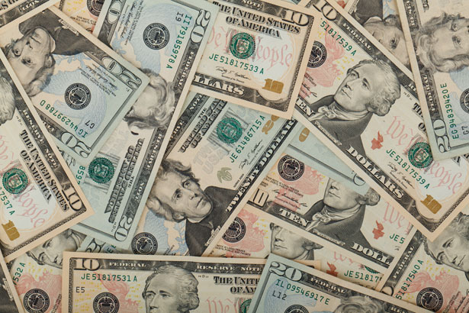
Treasurer’s report
10/27/22
ASSETS
Checking/Savings
Capital Reserve - DPW 10,727.54
Capital Reserve - Police 4,826.82
Crime Watch Fund 222.69
General Fund - Community 226,449.65
General Fund - FNB 5,891.51
Holiday Lights Fund 1,424.09

Slide 4
Treasurer’s report
Investment - General Fund 1,006.31
Investment - Liquid Fuels 33,975.79
Investment - Paving Fund 1,016.76
Investment - Recycling 5,027.35
Investment - Refuse 2,612.66
Liquid Fuels - FNB 31,001.65
Petty Cash 231.00
Recreations Fund 21,624.34
Recycling - Community 11,525.36
Refuse Checking - FNB 94,654.91
Total Checking/Savings 452,218.43

Slide 5
Treasurer’s report
200000 · Accounts Payable 162,722.72
Long Term Debt 245,818.13

